Slide 1
Manual Test Case Conversion – 05/02/2011
Ken Morris

Slide 2
Agenda
What are we trying to provide?
How are we going to provide this?
Who? Roles
Today - Manual Test Case Conversion
Roles – Manual Test Case Conversion
Conversion
Keyword
Questions
Additional

Slide 3
What are we trying to provide?
Better code coverage to detect errors and reduce the cost of failures
Repeatability to save time in a shortened test cycle and reduce the cost to market
Leverage exiting resources to improve productivity
Summary
Better code coverage for growing features in a shortened cycle with improved productivity

Slide 4
How are we going to provide
Manual Test Case Conversion
Automation Framework
Test Case Integrated Development Environment
Manual Test Case Conversion
Reduce the number of manual test cases
Test Case IDE
Create New Automated test cases
Automation Framework
Manage and execute automated test cases

Slide 5
Who – Roles High level
Tester
Executes and/or reviews results
Does not need programming skills
Does not need to know Test Complete but will learn
Test Case Developer/QA lead/ PD/SME
Designs and configures test cases
Programming skills are not required
Will learn how to interact with TC8 and TCIDE
Script Developer
Creates java script functions and high level keywords
Needs programming skills Java Script
Needs Test Complete skills
Framework Developer
Needs skills in automation framework development
Either Helios/STAF or similar.

Slide 6
Different Ways to Test
TestComplete supports the following types of testing
Keyword (Basic)
An abstraction layer that allows for “high level” (i.e. end user, non-technical user, sales person, etc. ) creation of test.
Having to know about operating system, windowing system, object organization, or code level information is not needed.
In TestComplete, these are created visually.
Not supported by current production test environment
Scripted (Advanced)
This is another abstraction layer that allows for “mid-level” (i.e. Test Complete subject matter experts, more familiar with application construction, etc.) test creation.
Allows for more complex operations, interfacing with other languages (possibly), etc.
Abstracts (mostly) the underlying operating system

Slide 7
Today – Manual Test Case Conversion
Today
Manual Test Case Conversion
Who – Two Roles
Test Case Developer/QA lead/ PD/SME
Script Developer
Manual Test Case Conversion
Automation Framework
Test Case Integrated Development Environment

Slide 8
Roles – Test Case Developer
Dual roles
Role 1
Learn how to convert using TC8 record mode
Role 2
Learn how to create New test cases from Keywords
Open RPDs
Report any issues
Conversion from Keyword recording to scripts
Assist Tester in tasks
Help tester in understand test cases
Help tester to learn execution of automated tests

Slide 9
Roles – Script Developer
Keywords
Developing Keywords in Test Complete
Representing new functions and tasks
Convert Keyword tests into Java Scripts
Create Keywords for existing functions
RPDs
Open and resolve RPDs based conversion and keywords
Work closely
Test Case Developer

Slide 10
Manual Test Case Conversion
Convert Test Plans
Manual Test Cases/Test Steps into Test Complete/Execute automated test cases
Location of Manual Test Cases
Justifier is the target application
Naturally there will be some that will have to remain as manual test cases.
We do this by taking manual tests and converting them into automated test steps by designated team members
FactSet experienced manual test case/test step writer
FactSet Experienced manual test case/test step execution
Role – Test Case Developer

Slide 11

Keyword - Convert Manual Test Case
Records test case manual steps
Use Test Complete 8 keyword recording mode
Play back your recording on your lap top
Open an RPD to create a test case
Send test to Ken or * by copy it into a QA directory
If you get stuck sent it to them anyway( still open RPD)

Slide 12
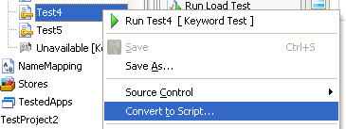
Keyword - Convert to Java Script
Script Developer
We will convert keyword tests into Java Script functions
Look for common functions to become utilities
Save the test cases and the utilities

Slide 13
QUESTIONS
Q and A

Slide 14
ADDITIONAL
Test Cases and Keywords

Slide 15
Test Cases(js) and Keywords – Test Complete
Test Project TC == Test Plan in Justifier
Test Unit TC == Test Case
Test Routine TC == Test Step
To keep it simple we’ll call a Test Unit a Test Case

Slide 16
TC – Test Case
Test Case
Uses a “Main” function as a wrapper around Test Steps
Test Steps
Are composed of
TC built-in functions
JS functions
Common Utilities
Common Utilities
Are a collection of related functions grouped together to perform common tasks
The Utility + Function has a high level name and accepts parameters.
For example UtilsFDSW.sj contains many functions that control FDSW
function ShowTerminalWindow() {
function GetSingleInstanceOfFDSWFrame(nSleepTime,bQuiet) {

Slide 17
TC – Test Case another example
UtilsCommon.sj
function DeleteFile(strPath, bCheckIfFileExists/*optional*/, bEatIfFileNotExist /* optional */) {
Called from a Test Case
if(!AssertNoError("UtilsCommon.DeleteFile",strTempPath+strScreenName+".xls"))
throw new UserError("[FSO Error]","The test file wasn't deleted.",STR_FUNCTION_NAME);
UtilsCommon.DeleteFile
Can be represented by a keyword for a Test Step
DeleteFile followed by parameters

Slide 18
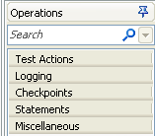
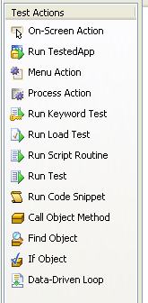
Process - Create New Automated Test Cases
Use Test Complete as our Test Case Integrated Development environment.
We will create Keywords in TCIDE to represent Operations.
These Operations will be linked to functions.
Those operations that are common will be listed under a common group name.

Slide 19
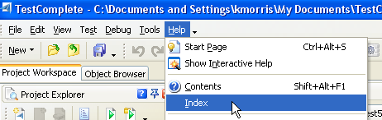
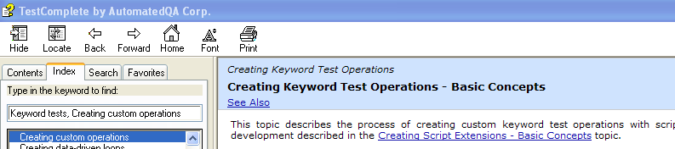
Process Goal – Develop Keyword Operations
Getting Started with Test Complete 8 PDF
http://downloads.automatedqa.com/docs/getting_started_with_testcomplete.pdf
Where to find information on how to develop keyword operations. Use the Help menu within Test Complete 8 and the Test Complete website.
Look at “Creating Keyword Test Operations – Basic Concepts” and
“Creating Script Extensions – Basic Concepts” for starters.

Slide 20
Automation Framework
We want to be able to execute these test cases on as many parallel machines as possible.
We do this by using a highly reliable, and scalable Software Test Automation Framework that will drive Test Execute
Framework Developer
Configuration
Execute automated test cases
Drive multiple copies of Test Execute
Report results
More in later PPTs

